Slide 1
Individual Slides
JetRacer Soccer League

Slide 2
ROS (Casey, Cooper)
Previous Work:​
Cont. ROS melodic setup
Setup GNOME VNC server
Created navigation package
(navigation topic + sub/pub)
Started integrating NVIDIA racecar package with ROS
Created package installation instructions doc (OS Flash, VNC, ROS, LiDAR)
Future Work:​
Configure package dependencies
Car tele-op control
Navigation stack (odometry?)

Slide 3
LiDAR (Arjun, Jarod)
Previous Work:
Setup hector SLAM (installed packages, troubleshooted)
Tested SLAM mapping capabilities
Tested for LiDAR crosstalk (no visible issues)
Future Work:
Look into odometry (could provide more accurate results with gmapping)
Mount LiDAR on cars, test mapping in real-world
Use SLAM maps to inform navigation

Slide 4
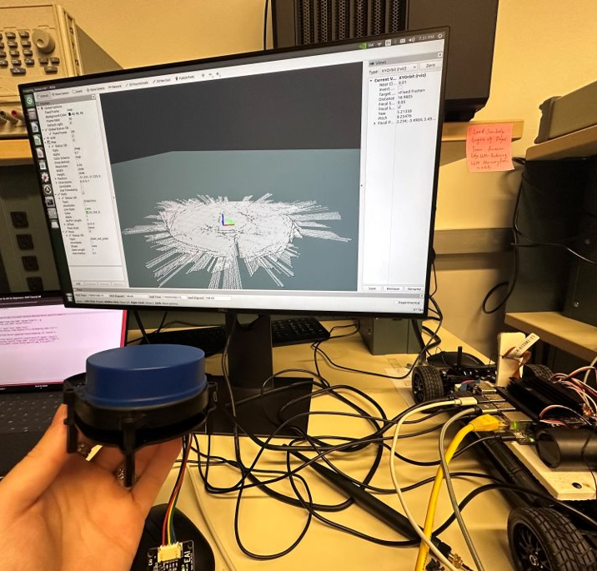
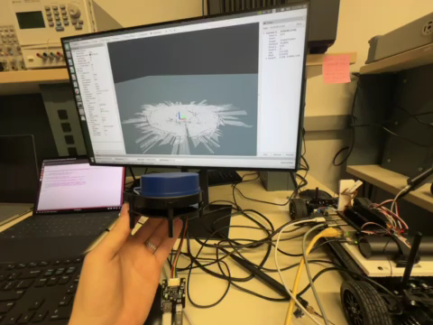
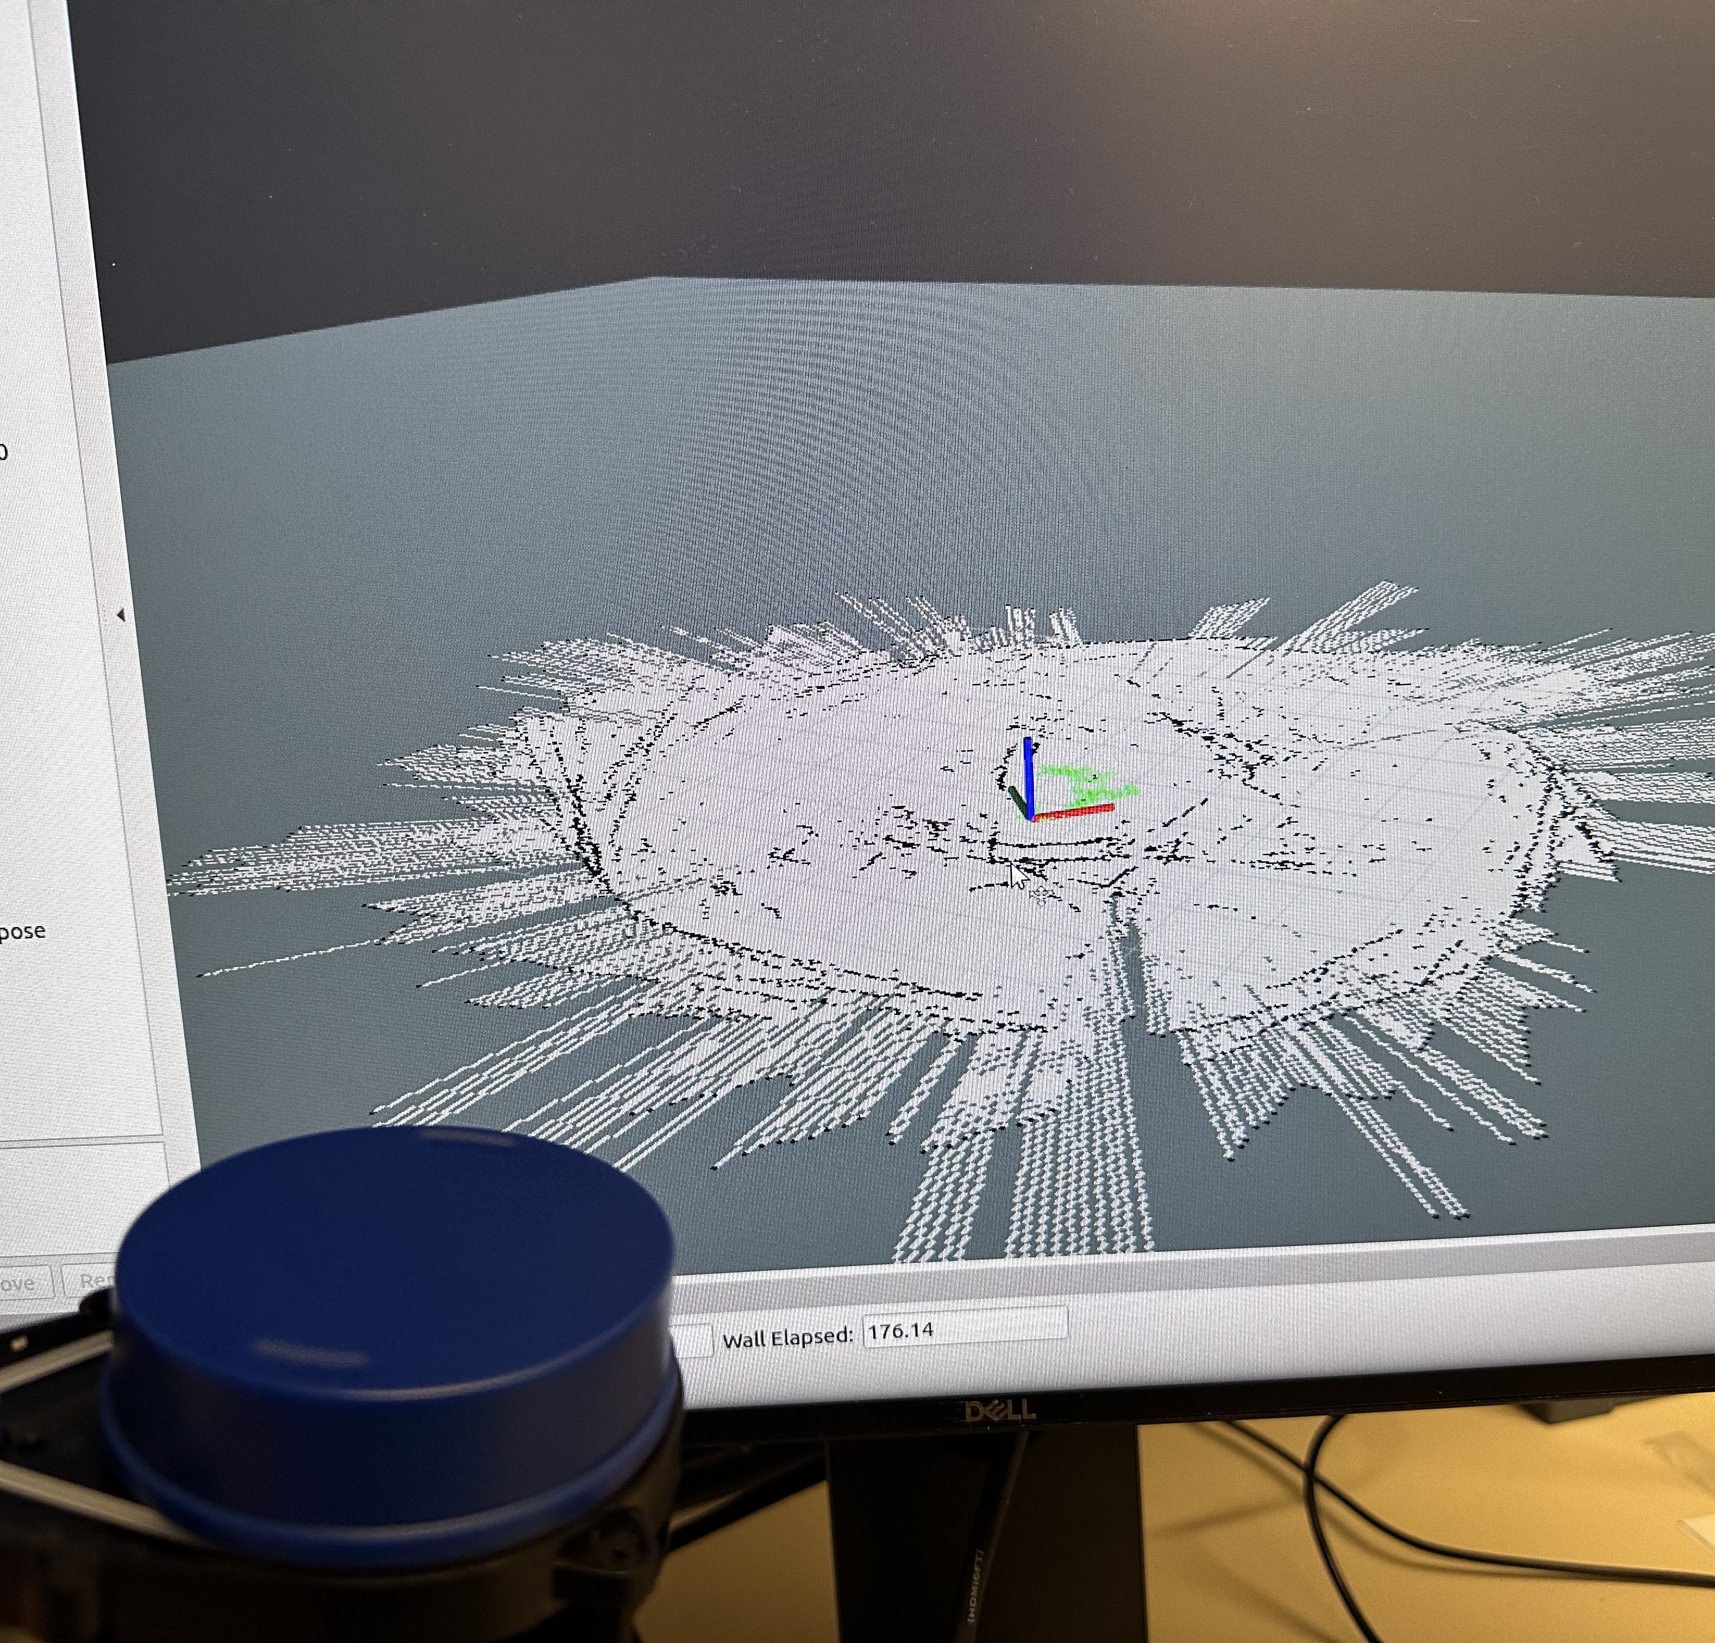
LiDAR (Arjun, Jarod)

Slide 5
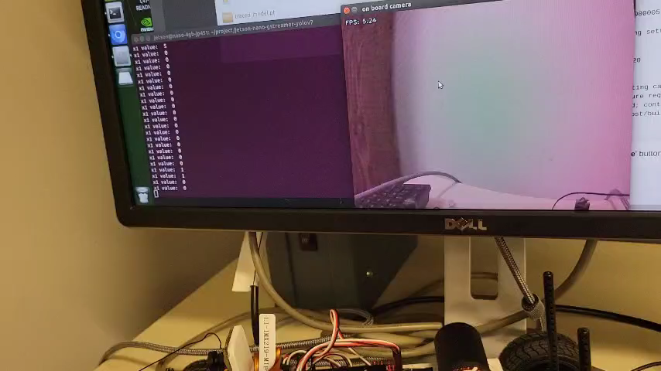
Object Recognition (K, Julie)
Previous work:
Object detection (YOLOv7) runs on car 4
Started looking into object following
Future work:
Get object detection working on all cars
May need to update image dataset depending on if field boundaries/cars look the same as previous years
Implement object following onto cars

Slide 6
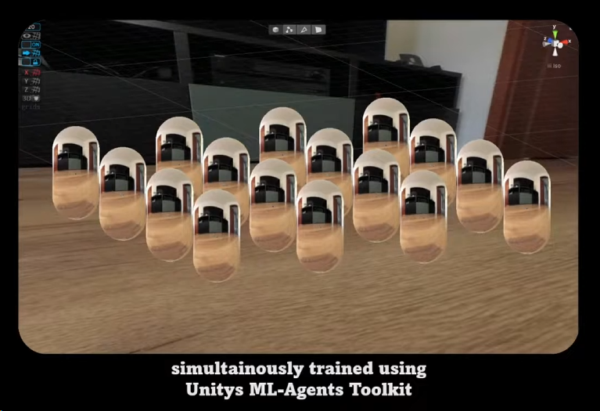
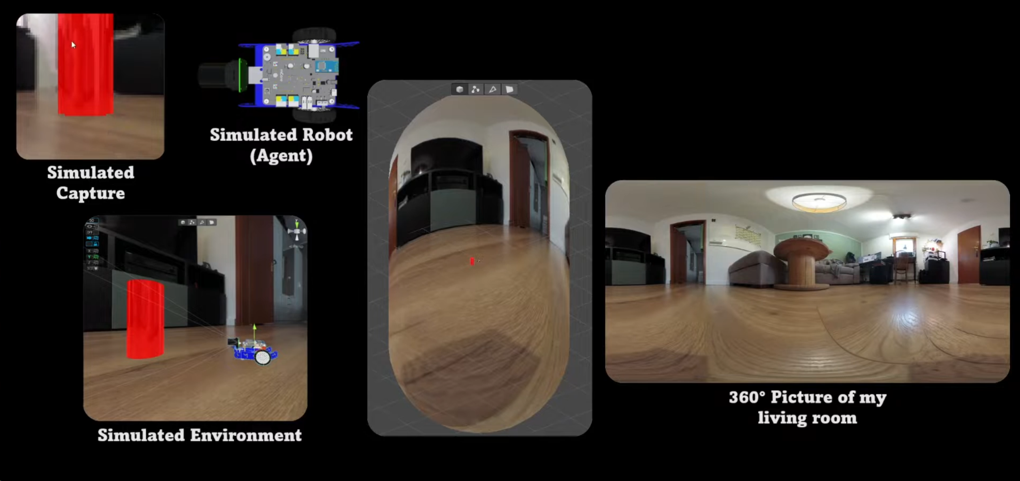
Unity (Mason)
Progress: Optimized the simulation further, looking to re-train some 1v1 fields as the industry mentors suggested.
For integration of Unity Simulation and JetRacer cars IRL:
Just a premature idea to utilize image recognition to identify objects, might require another onboard computer to process this, and a 360 camera could be a good idea.
Plan is to identify the cars and ball, and then execute certain commands in order to complete a 2v2 soccer game. The difficulty here is to stream the camera footage back to the Unity and translate the action values back to the cars.

